Slide 1

Lesson 7:
Partial Derivatives and Gradients

Slide 2


Introduction

Slide 3

Lecture Overview:
Goals of the lecture:
Understand partial derivatives and gradients

Slide 4
Partial Derivatives and Gradients

Slide 5
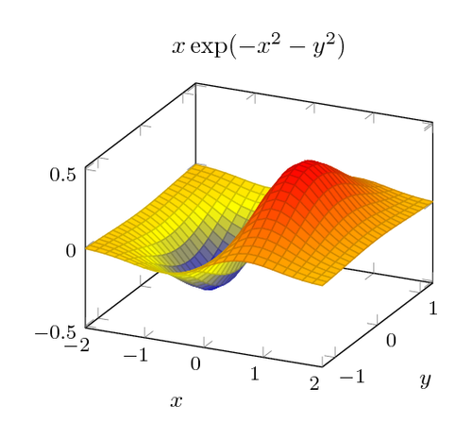

Partial Derivatives
$$f\left(x,y\right)=x^{2}−xy$$
$$\frac{∂}{∂x}f\left(x,y\right)=2x−y$$
$$\frac{∂}{∂y}f\left(x,y\right)=−x$$

Slide 6

Gradient
$$f\left(x,y\right)=x^{2}−xy$$
$$∇f\left(x,y\right)=\left[\begin{matrix}\frac{∂}{∂x} \\ \frac{∂}{∂y}\end{matrix}\right]$$
$$∇f\left(x,y\right)=\left[\begin{matrix}2x−y \\ −x\end{matrix}\right]$$

Slide 7

Summary
Operator
Symbol
Example
Derivative $\frac{d}{dx}$ $\frac{d}{dx}x^{3}=3x^{2}$
Partial Derivative $\frac{∂}{∂x}$ $\frac{∂}{∂x}x^{3}y={3x}^{2}y$
Gradient $∇$ $∇x^{3}y=\left[\begin{matrix}{3x}^{2}y \\ x^{3}\end{matrix}\right]$

Slide 8
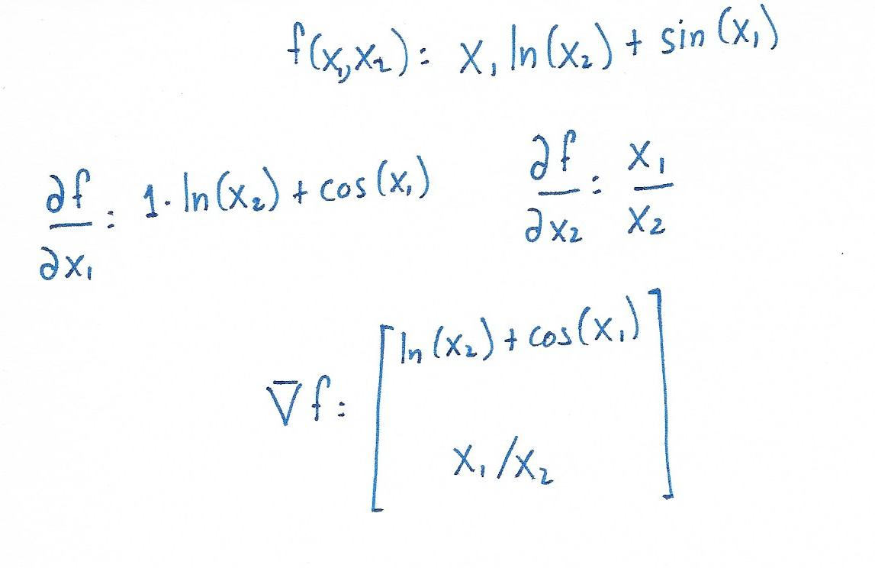
Problem 1:
Problem 1: Calculate the gradient.

Slide 9
Problem 1:
Problem 1: Calculate the gradient.

Slide 10
QUESTIONS?

